Slide 1



SUFRA.COM

Slide 2



Product or service
Sales Presentation | December 2020
Sufrah.com is a platform that brings together talented chefs in food preparation, allowing them to showcase their products for immediate sale or through pre-ordering. It offers a competitive environment to provide the best service at the most affordable prices.

Slide 3


Problem
Problem 2
There is no platform that offers homemade meals for employees, students, or expatriates.
Problem 1
There is no platform that brings together women working in homemade food products.

Slide 4



Solution
Solution 1
Providing support for women by showcasing their work.
Solution 2
Offering a variety of homemade food options.
Solution 3
Building trust between the customer and the service provider.

Slide 5
Key features
01
03
Feature 1
02
Feature 3
04
A feature that allows customers to leave feedback after each purchase, whether for the product or the chef.
A dedicated page for each chef to showcase their work and display their workspace, building trust with customers.
Feature 2
Feature 4
Fast delivary
Licensing all food providers.

Slide 6
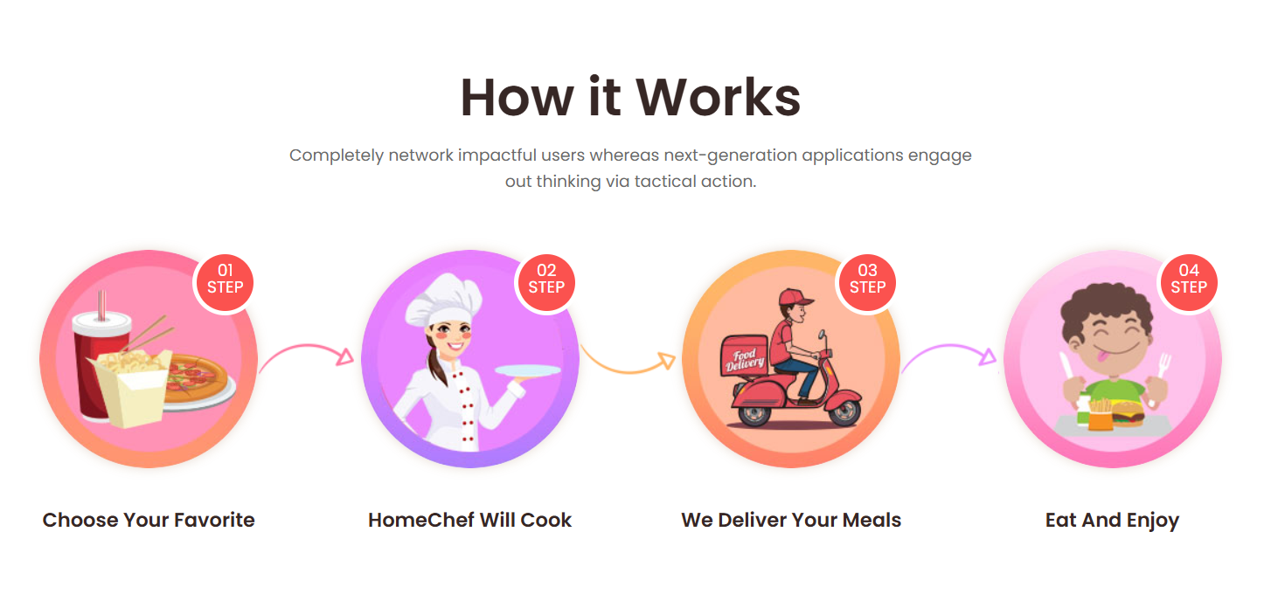
How it
works

Slide 7
Phases
01
02
Building an initial website to implement the idea
03
Working on marketing the website and attracting as many service providers and customers as possible.
Developing the website to enable chefs to easily list their products and have orders reach them

Slide 8
Contact us
Email Address
Nourothman. 944@gmail.com
Sales Presentation | December 2020
Phone Number
0789236132

